Slide 1
CMPE351 LAB5
DATABASE RELATIONSHIPS &
MYSQL WORKBENCH
CONTINUED

Slide 2
Multiple Primary Keys
It is possible that a table has multiple primary keys. When more than one column is defined as primary key on a table, it is called a "composite primary key”.
It is OK to define two primary keys for the Employee table. It is also possible to define just one of them as primary key. Note that you should make the non-primary key column "unique" if you are not using it as a primary key.
Composite primary keys are useful on weak entities and many-to-many relationships that require total participation.
If you wish to create a composite primary key on Workbench you can select multiple columns and check the PK check box. However, there is an additional step that is required, you must click the Indexes tab, then in the Index Columns panel you must set the desired order of the primary keys.

Slide 3
Composite and Derived Attributes
MySQL does not support composite attributes. Besides, having composite attributes in a database violates 1NF which we will cover later.
Instead, each part of the composite attribute should be taken out into a new table or be added into the original table as separate columns.
You should not define a column for derived attributes. They usually represent statistical information about the current state of a table.

Slide 4
Multivalued Attributes
You should store multivalued attributes in a new table, which has many-to-many relationship with the original table. This means two more tables in total: one for multivalued attributes, one for m-to-n relationship.
In COMPANY database, a table named “Location” should be created. Consider this situation like:
One department can exist in many locations, and there can also be many departments in one location. This implies a many-to-many relationship between Department and Location tables, and enforces an extra table for many-to-many relationship.
Note that "Project" table has a Location attribute, which indicates that "Location" table is also useful here.

Slide 5
Relationship Attributes
If those attributes belong to a many-to-many relationship, they should be included in the many-to-many table.
If they appear to be in a one-to-one or one-to-many relationship, they should be added to the table with the foreign key.
In COMPANY database, the relationship "MANAGES" has "StartDate" attribute. Since each department can have one manager(one-to-one relationship), you can define columns for EmployeeID and StartDate (as ManagerID and ManagerStartDate) on Department table.

Slide 6
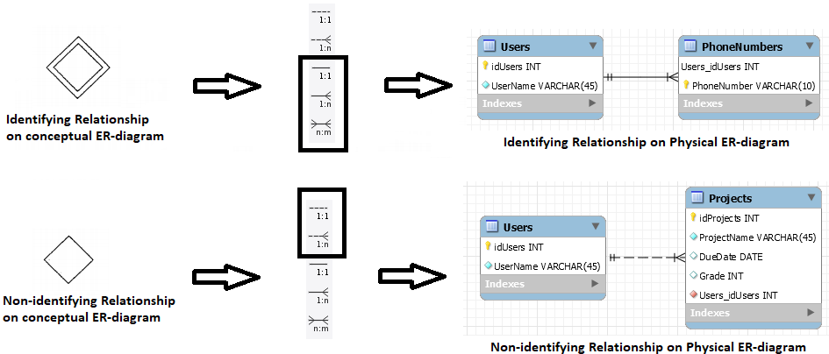
Identifying vs Non-Identifying Relationships

Slide 7
Identifying Relationships
An identifying relationship can exist between a strong and a weak entity type, where weak entity's foreign key is part of its primary key.
In COMPANY database, existance of a "Dependent" entity depends on existance of an "Employee", meaning that if an employee is deleted from the database, related dependents should also be deleted(referential integrity). This functionality can be achieved using solid lines on MySQL Workbench.

Slide 8
Non-Identifying Relationships
Non-identifying relationships are relationships between strong entity types, each having their own key specified. These relationships do not enforce referential integrity on the related tables.
A non-identifying relationship can be optional or mandatory, which means the foreign key column allows NULL or disallows NULL, respectively.
Use dashed lines on MySQL Workbench for non-identifying relationships.

Slide 9
Participation Constraints
Total participation: All the entities in a table must participate in the relationship.
Partial participation: Entities may or may not participate in the relationship.
In COMPANY database each department must have a manager while only a few of the employees are managers. In this relationship department table is participating totally, on the other hand employee table participates partially.
In MySQL Workbench EER-diagram, participation constraints can be represented as shown in the following slides:

Slide 10
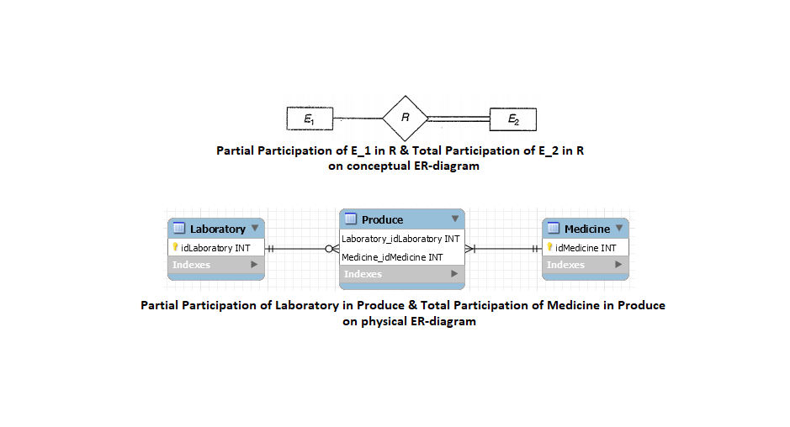
Total vs Partial Participation

Slide 11
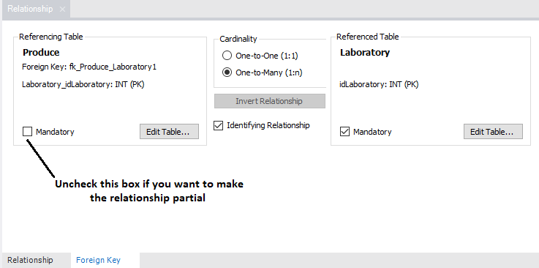
How to represent participation constraints on Workbench
Double click on the relationship, see the Relationship tab below

Slide 12
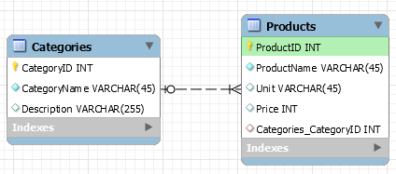
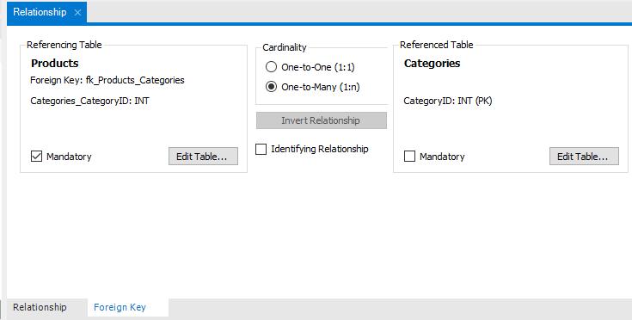
How to represent participation constraints on Workbench
For 1-to-n or 1-to-1 relationships, double click on the relationship again, and uncheck the mandatory box on the desired foreign key:

Slide 13
Total/Partial Participation vs Identifying/Non-identifying Relationships
Weak entities always participate totally in an identifying relationship. They can not participate in any relationship partially. So identifying relationships always enforce total participation on weak entities.
But total participation does not imply that there is an identifying relationship (i.e. "WORKS_ON" relationship is non-identifying but requires total participation from both tables).
Partial participation in a non-identifying relationship is very common.
Note that a participation constraint on its own does not imply anything about existence of an entity type. They state whether entities of a table must or may/may not be in a relationship.

Slide 14
Exercise
Using MySQL Workbench;
Create a table named “Department” with the fields “idDepartment” (int) as primary key, “DepartmentName” (varchar).
Create another table named “Project” with the fields “idProject” (int) as primary key, “ProjectName” (varchar), “Budget” (int) and “StartDate” (date).
Create one-to-n non-identifying relationship named “Controls” between “Department” and “Project” tables, where one department may control zero or many projects whereas a project must be controlled by only one department. Double click on the relation you created and set the participation constraints by checking/unchecking “Mandatory” checkboxes from “Foreign Key” tab.
Press CTRL+P to export your EER Diagram as pdf.
Press CTRL+Shift+G (or File/Export/Forward Engineer) in order to generate CREATE script. Click “Next”, click “Next” again and click “Copy to Clipboard”. Then paste the copied script into a txt file named “Lab5.txt”
Submit the pdf you exported on question 4 and the script “Lab5.txt” on question 5 to the blackboard.

